Slide 1
Why and when to use Node.js
NODE.JS PROS
USE NODE.JS
Single-threaded, based on event driven, non-blocking I/O model
Perfect for building fast and scalable data-intensive apps;
Javascript across the entire stack: faster and more efficient development;
NPM: huge library of open-source packages avaiable for everyone for free;
Very active developer community.
API with database behind it (preferably NoSQL);
Data stream (think YouTube);
Real-time chat application;
Server-side web application;
DON’T USE
Applications with heavy server-side
processing(CPU-intensive)

Slide 2
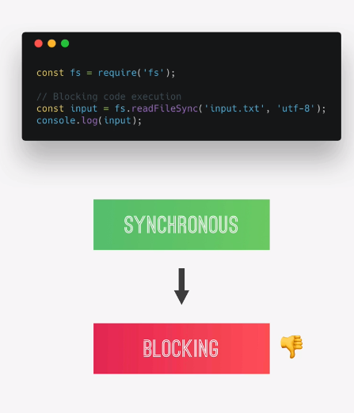
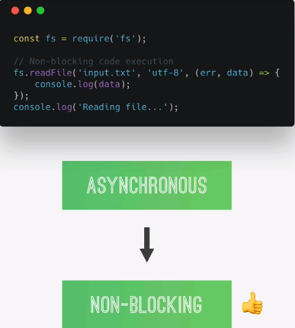
Synchronous vs Asynchronous Code (Blocking vs Non-Blocking)
Synchronous
Asynchronous

Slide 3
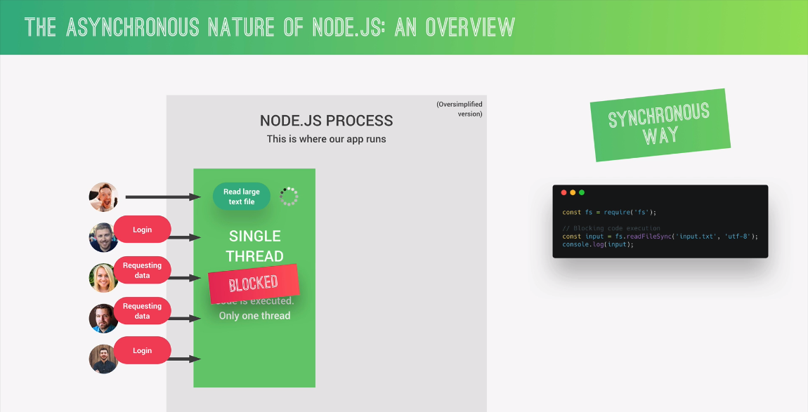

Slide 4
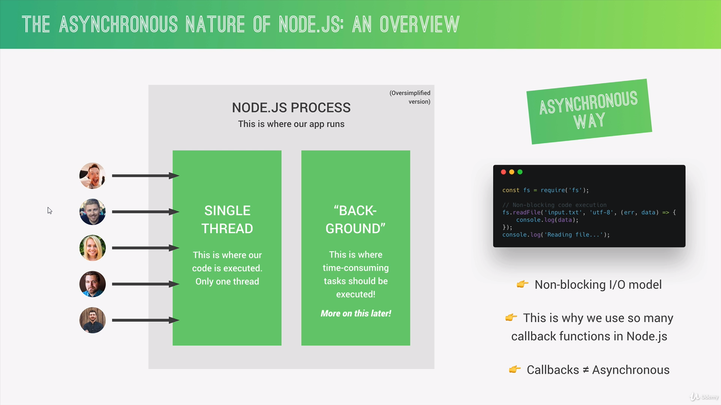

Slide 5
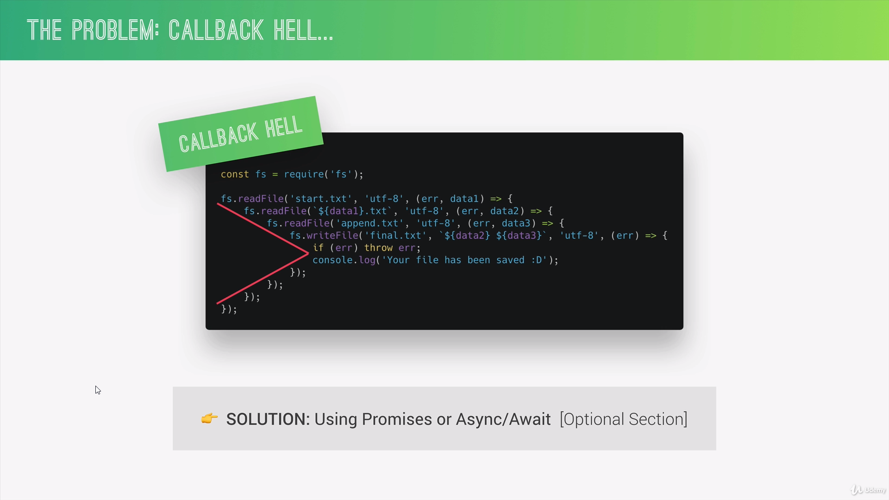

Slide 6
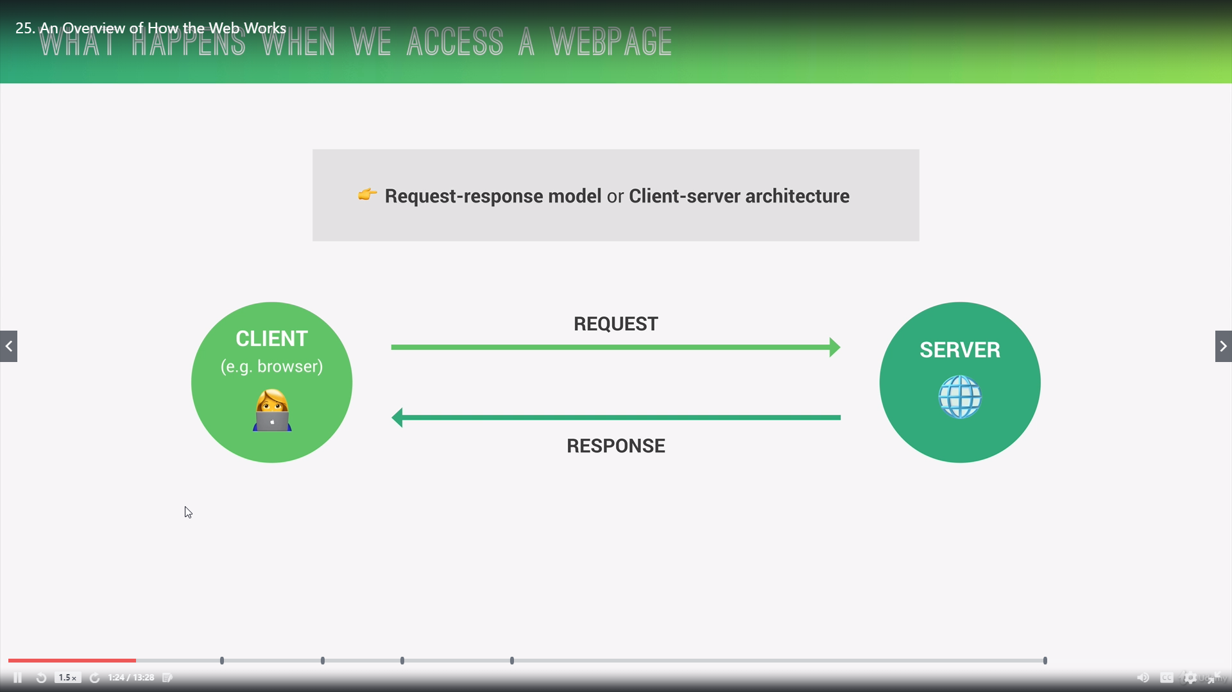

Slide 7
